Slide 1
Evaluation Reforms and Outcome Based Education
Prof. Urmila Patil
Professor (ECE),
Former Dean Academics,
Former IQAC coordinator,
Dr. D. Y. Patil Institute of Technology, Pimpri, Pune 18.

Slide 2
Outcome Based Education
Outcome-Based Education (OBE) is a student-centric teaching and learning methodology in which the course delivery, assessment are planned to achieve stated objectives (goals) and outcomes.
Starting with a clear picture of what is important for students to be able to do…
Then organizing the curriculum, delivary and assessment to make sure learning happens…

Slide 3
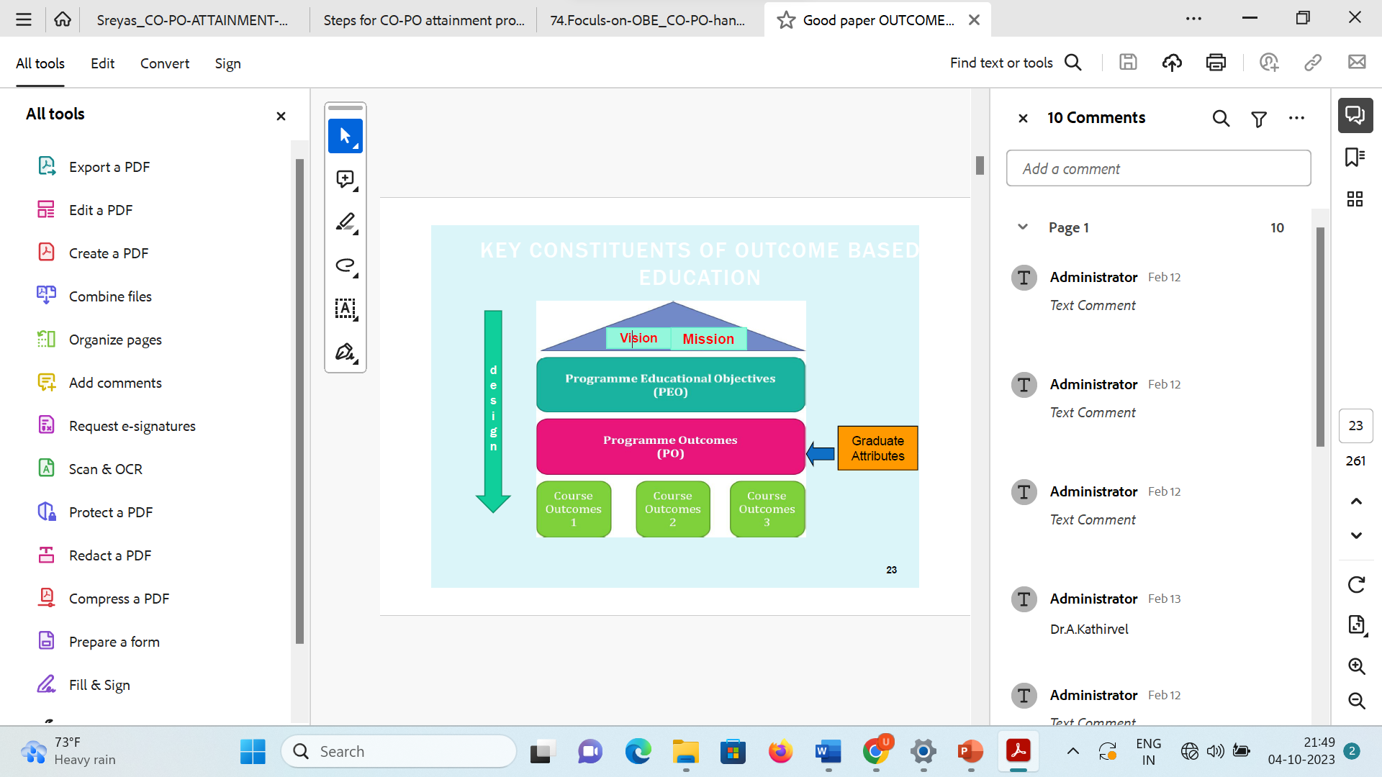
Outcome Based Education

Slide 4
Objectives (Goals)
A VISION is your Institute's goal …..Where you hope to see it in the future. This leads to Vision of the department or program.
A Vision statements needs to be proactive, concise and easy to recall.
Institute and Department Mission statements show the actions taken to achieve the respective visions.
PEOs are consistent with dept. mission and indicate Preparedness of the graduates to attain career and professional accomplishments within a few year( preferably in 3-5 years) of graduation as, Preparation (Employment/Higher studies), Core competence(Discipline knowledge), Breadth (Skills, Research), Professionalism (training/ III), Life long learning (Environment).

Slide 5
Dissemination of Vision, Mission and PEOs among stakeholders
Vision and Mission statements are displayed at the following prominent places
1. Entrance of the Department 2. HOD office
3. Laboratories 4. Notice Boards
5. Department Library 6. Course files/ Laboratory Manuals
7. Newsletters and Magazine Student’s Diary 8. Institute website
9. Departmental website 10. Departmental Brochure(s)
Vision and Mission statements are disseminated to all the stakeholders of the
programs during meetings (parents meet, alumni meet etc.) and Departmental
Presentations, etc.

Slide 6
Outcomes
Program Outcomes (POs) : describe what students are expected to know and would be able to do by the time of graduation. These relate to the skills, knowledge, and behaviors that students acquire as they progress through the program.
Program Specific Outcomes (PSO): PSOs are outcomes that are specific to a program. PSOs characterize the specificity of the core courses of a program. PSOs can be 2 to 4 in number.
Course Outcomes (CO): Course Outcomes (COs) are what the student should be able to do at the end of a course. The most important aspect of a CO is that it should be observable and measurable

Slide 7
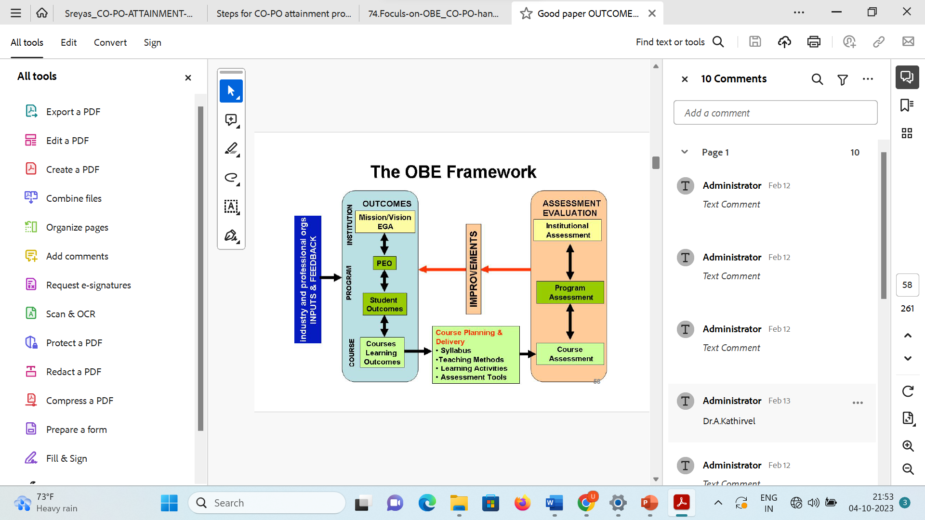

Slide 8
Program Curriculum
The courses in the curriculum are defined into the following course components:
Basic Courses
Core Courses
Humanities and Social Sciences courses
Management courses
Professional courses
Subject Elective courses
Open Elective courses
Project and Seminars

Slide 9
Program Curriculum
Curriculum- affiliated institutions-Tasks for outcome attainment
Analyze the University Curriculum
Determine the Gaps in Attainment of POs
Design Extra modules or Assessments to Bridge these gaps (Content beyond syllabus)
Need a few iterations for their impact on attainment and hence quality of outcomes.

Slide 10
Program Curriculum gaps
Curricular gap for the attainment of defined POs & PSOs
Horizontal and Vertical gaps
Sr No | Gap Number | Gap
1 | Gap 1 | Inadequate Industry Exposure
2 | Gap 2 | Keeping Pace with Technological Advancement
3 | Gap 3 | Necessity of Professional Engineering Practice and Value Added Courses

Slide 11
Teaching - Learning Processes
Academic Calendar
Pedagogical initiatives
Weak and Bright students
Classroom and Lab teaching
Continuous Evaluation
Quality of student projects
Initiative related to outside institute interaction
Initiatives related to internship / Training
Student feedback of T-L and action taken there of

Slide 12
Teaching - Learning Processes
Internal Question Papers
Internal examination schedule is provided in the academic calendar.
Departmental Class test coordinator prepares class test and prelim time table and invigilation duty slot for smooth conduction of examination.
Question Paper setting by considering level of blooms taxonomy and map the questions with COs and PSOs.
The question paper set by the course teacher is discussed in Cohort cluster to ensure quality of question paper.
A sample question paper is to be kept as the documentary evidence.

Slide 13
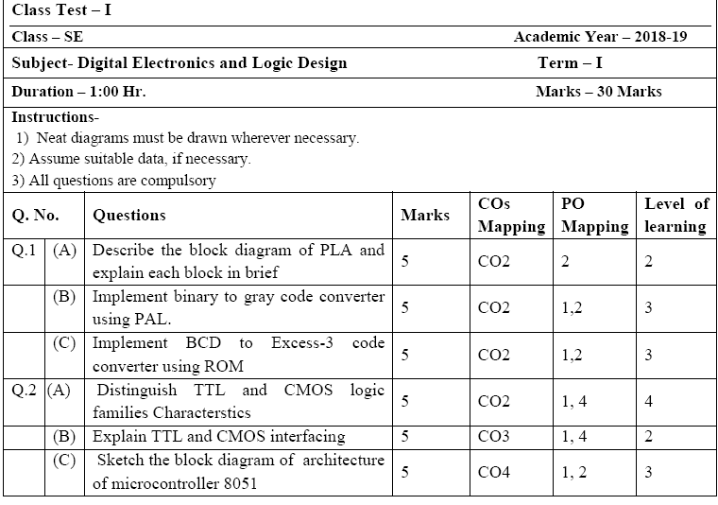
Teaching - Learning Processes
Sample question paper

Slide 14
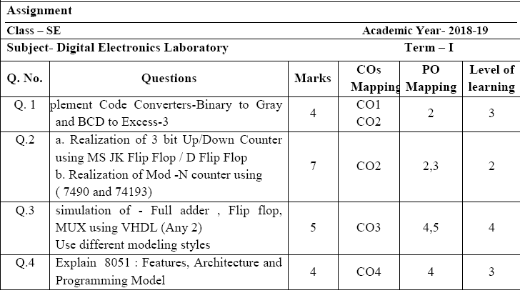
Teaching - Learning Processes

Slide 15
Teaching - Learning Processes
Quality of student projects
  Allocation Procedure of Project Guide and Topic
  Types and relevance of the projects and their contribution towards attainment of POs and PSOs
  Process for monitoring and evaluation
  XYZ Univ. Guidelines for evaluation of project work
  Process to assess individual and team performance
  Quality of completed projects/working prototypes
  Papers published /Awards received by Projects

Slide 16
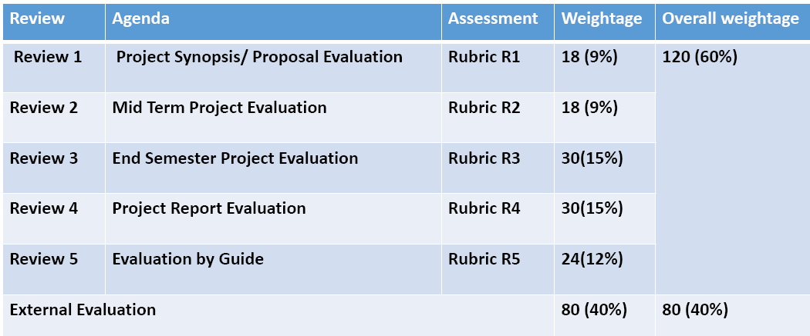
Teaching - Learning Processes
Rubrics for Project evaluation : Weekly meetings with respective guide on the project day as allotted in the timetable and Departmental Project Committee evaluates student group periodically

Slide 17
Establish the correlation Cos-POs and COs-PSOs
Enter correlation levels 1, 2 or 3 as defined below: 1- Slight (Low) 2- Moderate (Medium) 3- Substantial (High) It there is no correlation, put “-” .
Class | Course Name | CO | PSO 1 | PS0 2 | PS0 3
SE | Digital Electronics | C205.1 | 3 | - | -
 |  | C205.2 | 3 | - | -
 |  | C205.3 | 3 | - | 1
 |  | C205.4 | 3 | 1 | 1

Slide 18
Establish the correlation between the courses and POs and PSOs
Program level Course-PO matrix of all courses INCLUDING first year courses
Year | Course | 1 | 2 | 3 | 4 | 5 | 6 | 7 | 8 | 9 | 10 | 11 | 12
First Year | C101 | 3.00 | 3.00 | 2.00 | 0.00 | 0.00 | 0.00 | 0.00 | 0.00 | 0.00 | 0.00 | 0.00 | 0.00
 | C102 | 2.33 | 2.00 | 0.00 | 0.00 | 0.00 | 2.00 | 0.00 | 0.00 | 0.00 | 0.00 | 0.00 | 0.00
 | C103 | 2.33 | 2.33 | 0.00 | 2.33 | 2.67 | 0.00 | 0.00 | 2.00 | 2.67 | 2.67 | 2.33 | 1.67
 | C104 | 3.00 | 3.00 | 0.00 | 1.33 | 2.00 | 1.33 | 2.00 | 1.33 | 3.00 | 2.00 | 1.33 | 2.00
 | C105 | 3.00 | 2.00 | 0.00 | 0.00 | 0.00 | 0.00 | 2.00 | 0.00 | 1.00 | 0.00 | 0.00 | 0.00
 | C106 | 3.00 | 2.50 | 1.00 | 0.00 | 2.00 | 0.00 | 0.00 | 0.00 | 0.00 | 0.00 | 0.00 | 2.00
 | C107 | 3.00 | 3.00 | 3.00 | 0.00 | 0.00 | 0.00 | 0.00 | 0.00 | 0.00 | 0.00 | 0.00 | 0.00
 | C108 | 1.67 | 2.00 | 1.00 | 0.00 | 0.00 | 2.00 | 2.00 | 0.00 | 0.00 | 0.00 | 0.00 | 0.00
 | C109 | 3.00 | 3.00 | 3.00 | 1.33 | 0.00 | 0.00 | 2.67 | 0.00 | 0.00 | 0.00 | 0.00 | 0.00
 | C110 | 3.00 | 2.00 | 0.00 | 0.00 | 0.00 | 0.00 | 0.00 | 0.00 | 0.00 | 0.00 | 0.00 | 0.00
 | C111 | 2.67 | 2.00 | 1.00 | 0.00 | 1.00 | 0.00 | 0.00 | 0.00 | 1.00 | 0.00 | 0.00 | 1.00
 | C112 | 3.00 | 2.00 | 2.00 | 0.00 | 1.50 | 0.00 | 0.00 | 0.00 | 0.00 | 0.00 | 0.00 | 2.00
----------
Average values of POs | 2.54 | 2.38 | 1.92 | 1.63 | 1.75 | 1.42 | 1.29 | 1.23 | 1.53 | 1.45 | 1.36 | 1.50

Slide 19
Attainment of Course Outcomes
  Data collection processes for evaluation of CO attainment may include, but are not limited to,
  Internal exam or tests/tutorial questions
  assignments
  laboratory tests
  project evaluation
  student portfolios (A portfolio is a collection of artifacts that demonstrate skills, personal characteristics and accomplishments created by the student during study period)

Slide 20
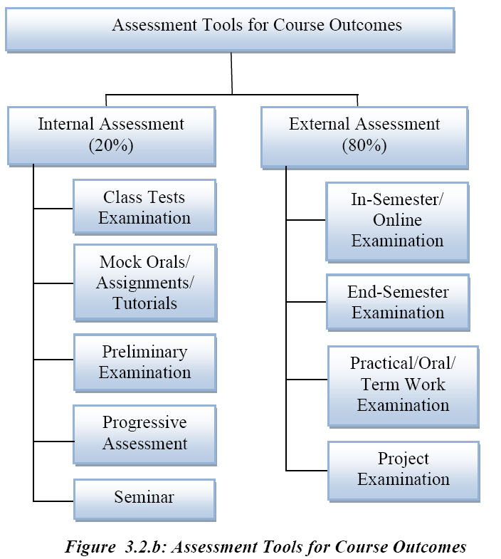
Attainment of Course Outcomes

Slide 21
Attainment of Course Outcomes
  Record the attainment of Course Outcomes of all courses with respect to set attainment levels
  The attainment levels shall be set considering average performance levels in the university examination or any higher value set as target for the assessment years.
  Attainment level is to be measured in terms of student performance in internal assessments with respect to the Course Outcomes of a course in addition to the performance in the University examination

Slide 22
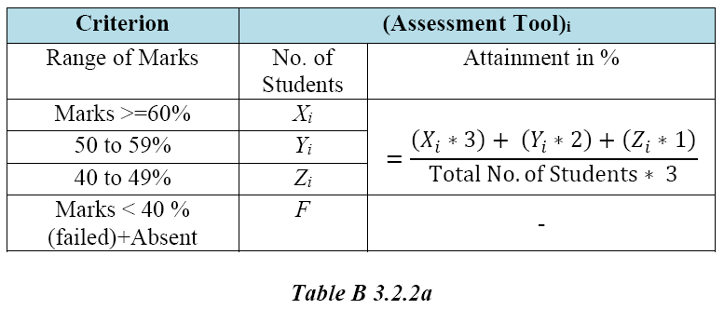
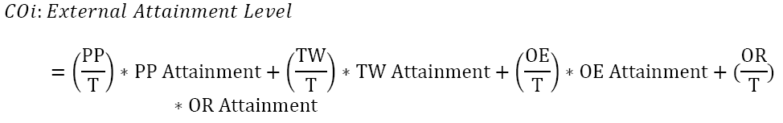
Attainment of Course Outcomes
Where, PP- Theory Paper, TW- Term work, OE- Online Exam, OR – Oral, T- No. of Assessment tools

Slide 23
Attainment of Course Outcomes
  Measuring CO attainment through Internal Assessments:
  Example : Mid-term test 1 addresses C202.1 and C202.2. Out of the maximum 20 marks for this test 12 marks are associated with C202.1 and 8 marks are associated with C202.2.
  Attainment Level 1: 60% students scoring more than 60% marks out of the relevant maximum marks.
  Attainment Level 2: 70% students scoring more than 60%
  Attainment Level 3: 80% students scoring more than 60%
  Attainment is measured in terms of actual percentage of students getting set percentage of marks. If targets are achieved then the C202.1 and C202.2 are attained for that year. Program is expected to set higher targets for the following years as a part of continuous improvement.
  If targets are not achieved the program should put in place an action plan to attain the target in subsequent years.

Slide 24
3.2 Attainment of Course Outcomes
  3.2.2. Record the attainment of Course Outcomes of all courses with respect to set attainment levels (40)
  Measuring CO attainment through Internal Assessments:
  Target may be stated in terms of percentage of students getting more than class average marks or set by the program in each of the associated COs in the assessment instruments (midterm tests, assignments, mini projects, reports and presentations etc. as mapped with the COs)

Slide 25
Attainment of Course Outcomes
  Measuring Course Outcomes attained through University Examinations
Attainment Level 1: 60% students scoring more than University average percentage marks or set attainment level in the final examination.
Attainment Level 2: 70% students
Attainment Level 3: 80% students
Attainment is measured in terms of actual percentage of students getting set percentage of marks.
If targets are achieved then all the COs are attained for that year.
Program is expected to set higher targets for the following years as a part of continuous improvement.
If targets are not achieved the program should put in place an action plan to attain the target in subsequent years.

Slide 26
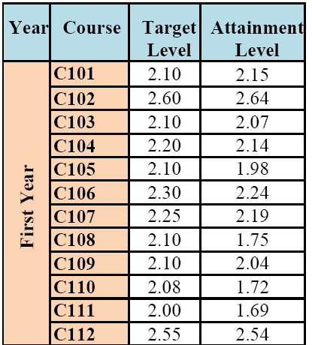
Attainment of Course Outcomes
  Attainment through University Examination: Substantial i.e. 3
  Attainment through Internal Assessment: Moderate i.e. 2
  Assuming 60% weightage to University examination and 40% weightage to Internal assessment, the attainment calculations will be
  60% of 3 + 40% of 2 = 1.8 + 0.8 = 2.6

Slide 27
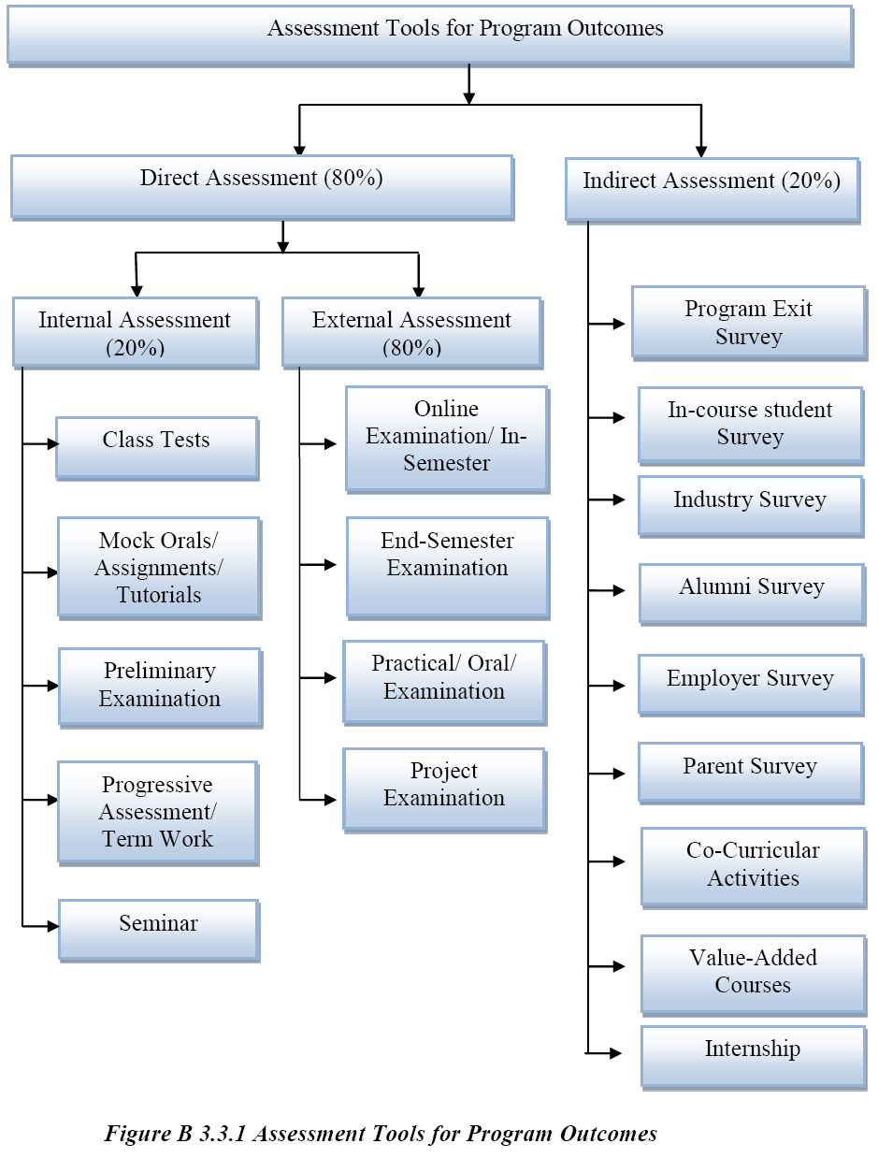

Slide 28
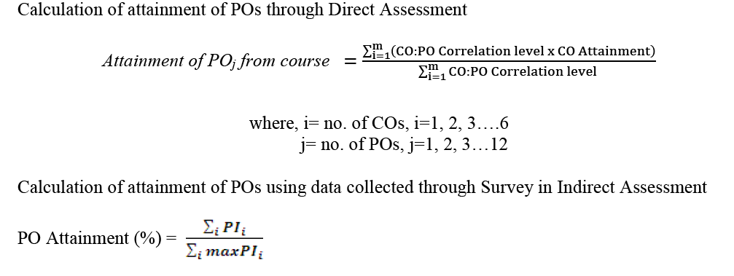
Attainment of POs and PSOs

Slide 29
Attainment of POs and PSOs
  Provide results of evaluation of each PO & PSO
  Example:
  1. It is assumed that a particular PO has been mapped to four courses C2O1, C3O2, C3O3 and C4O1
  2. The attainment level for each of the four courses will be as given in 3,2,2
  3. PO attainment level will be based on attainment levels of direct assessment and indirect assessment
  4. For affiliated, non-autonomous colleges, for overall attainment level 80% weightage may be given to direct assessment and 20% weightage to indirect assessment through surveys from students(largely), employers (to some extent).
  Program may have different weightages with appropriate justification.

Slide 30
Attainment of POs and PSOs
  Example contd..
  Direct Assessment: C201 –High (3) ; C302 – Medium (2) ; C303 – Low (1) ;C401 – High (3)
  Attainment level will be summation of levels divided by no. of courses 3+2+1+3/4= 9/4=2.25
  Indirect Assessment Surveys, Analysis, customized to an average value as per levels 1, 2 & 3.
  Assumed level - 2
  6. PO Attainment level will be 80% of direct assessment + 20% of indirect assessment i.e. 1.8 + 0.4 = 2.2.
  Note: Similarly for PSOs.

Slide 31
Thank You..

